Slide 1
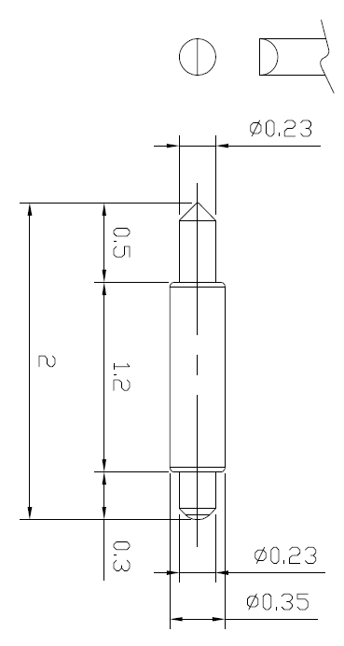
※ High speed POGO pin – 2.0mm / 0.5P
IVB-DAR-200-035-A221-00
Pitch | 0.35mm
Total Length | 2.0mm
Use Length | 1.7mm
Use Stroke | 0.3mm
Max Stroke | 0.4mm
Spring Force at Use Stroke | 10gf at 0.3mm Stroke
Operating Temperature | -40 to 200°C
DC Resistance | Avg. 59.0mΩ at 0.3mm stroke
Current Rating (Continuous) | 2.0 A
Self Inductance | 0.61 nH
Bandwidth @ -1dB | 45.8 GHz
Insertion Life | 100,000 cycles

Slide 2
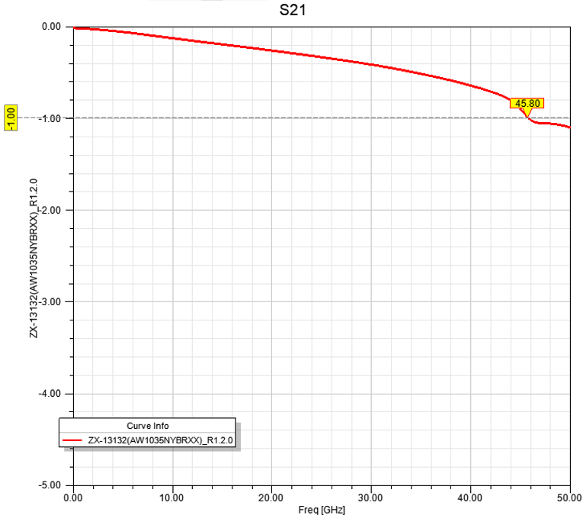
※ High speed POGO pin – 2.0mm / 0.5P

Slide 3
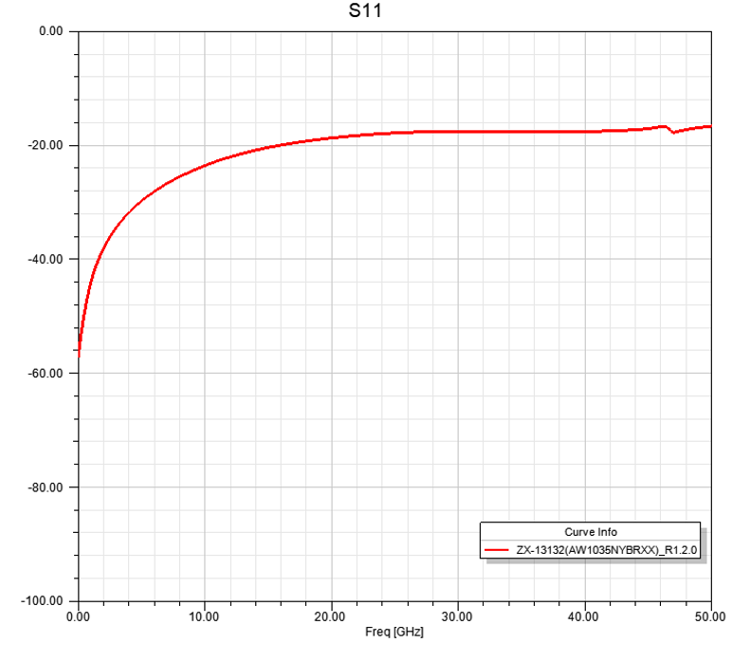
※ High speed POGO pin – 2.0mm / 0.5P

